Slide 1
Mixed Costs
Chapter 2
Notes:
Chapter 2: Managerial Accounting and Cost Concepts. In this chapter we explain how managers need to rely on different cost classifications for different purposes. The four main purposes emphasized in this chapter include preparing external financial reports, predicting cost behavior, assigning costs to cost objects, and decision making.

Slide 2
Mixed Costs
Many costs are really mixed in nature.
  Have a fixed and variable component.
In order to work with and forecast costs, mixed costs must be broken down into variable and fixed components.
  We will look at two ways to accomplish this.
    High Low Method
    Least Squares Regression

Slide 3
Mixed Costs
(also called semivariable costs)
A mixed cost contains both variable and fixed elements. Consider the example of utility cost.
Y
Total mixed cost
Total Utility Cost
Variable
Cost per KW
X
Fixed Monthly
Utility Charge
Activity (Kilowatt Hours)
Notes:
Mixed costs (also called semivariable costs) contain both variable and fixed cost elements.
The graph depicts the mixed costs of a normal utility bill. As illustrated in the graph, a utility bill contains a fixed and a variable cost component.
The fixed portion of the utility bill is constant regardless of kilowatt hours consumed. This cost represents the minimum cost that is incurred to have the service ready and available for use.
The variable portion of the utility bill varies in direct proportion to the consumption of kilowatt hours.

Slide 4
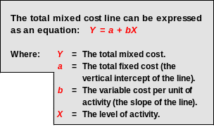
Mixed Costs
Y
Total mixed cost
Total Utility Cost
Variable
Cost per KW
X
Fixed Monthly
Utility Charge
Activity (Kilowatt Hours)
Notes:
The mixed cost line can be expressed with the equation Y = a + bX. This equation should look familiar, from your algebra and statistics classes.
In the equation, Y is the total mixed cost; a is the total fixed cost (or the vertical intercept of the line); b is the variable cost per unit of activity (or the slope of the line), and X is the actual level of activity.
In our utility example, Y is the total mixed cost; a is the total fixed monthly utility charge; b is the cost per kilowatt hour consumed, and X is the number of kilowatt hours consumed.

Slide 5
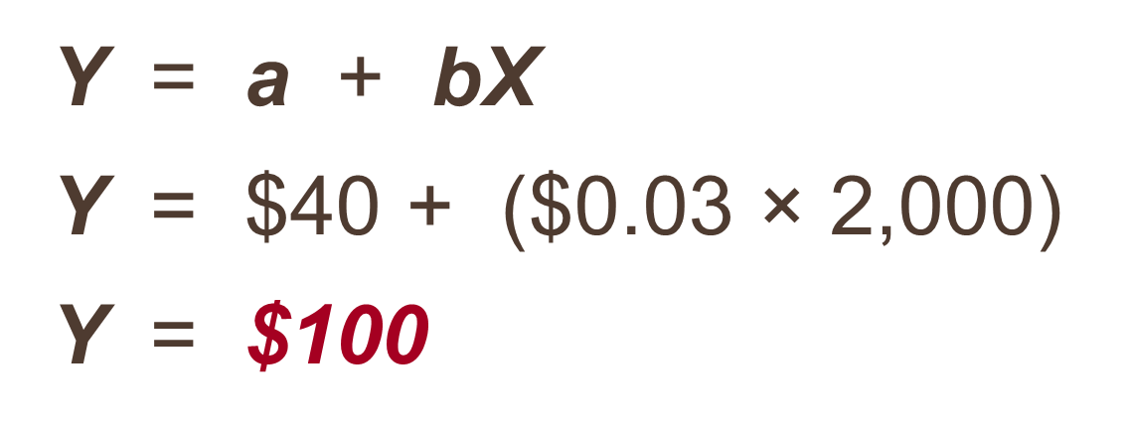
Mixed Costs – An Example
If your fixed monthly utility charge is $40, your variable cost is $0.03 per kilowatt hour, and your monthly activity level is 2,000 kilowatt hours, what is the amount of your utility bill?
Notes:
Read through this short question to see if you can calculate the total utility bill for the month.
The total bill is $100. How did you do?

Slide 6
Learning Objective 4
Analyze a mixed cost using a scattergraph plot and the high-low method.
Notes:
Learning objective number 4 is to analyze a mixed cost using a scattergraph plot and the high-low method.

Slide 7
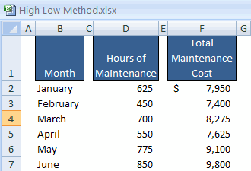
Scattergraph Plots – An Example
Assume the following hours of maintenance work and the total maintenance costs for six months.
Notes:
The high-low method can be used to analyze mixed costs if a scattergraph plot reveals a linear relationship between the X and Y variables. For illustrative purposes, assume the information regarding hours of maintenance work and the total maintenance costs for six months as shown on this slide.

Slide 8
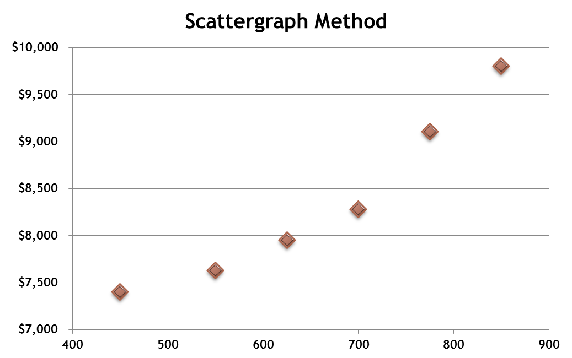
The Scattergraph Method
Plot the data points on a graph (Total Cost Y vs. Activity X).
Y
Total Maintenance Cost
X
Hours of Maintenance
Notes:
A scattergraph plot (also called the quick-and-dirty method) is a quick and easy way to isolate the fixed and variable components of a mixed cost.
The first step when using this method to analyze a mixed cost is to plot the data on the scattergraph. The cost, which is known as the dependent variable, is plotted on the Y (vertical) axis. The activity, which is known as the independent variable, is plotted on the X (horizontal) axis.
The second step is to examine the dots on the scattergraph to see if they are linear, such that a straight line can be drawn that approximates the relation between cost and activity. If the dots are not linear, do not analyze the data any further. Instead, search for another independent variable that bears a stronger linear relationship with the dependent variable.
If there does appear to be a linear relationship between the level of activity and cost, we will continue our analysis.

Slide 9
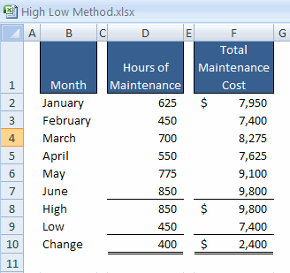
The High-Low Method – An Example
The variable cost per hour of maintenance is equal to the change in cost divided by the change in hours.
$2,400
400
= $6.00/hour
Notes:
The first step is to choose the data points pertaining to the highest and lowest activity levels. In this case, the high level of activity was in June at 850 hours of maintenance and the low level of activity is in February with 450 hours of maintenance. Notice that this method relies upon two data points to estimate the fixed and variable portions of a mixed cost, as opposed to one data point with the scattergraph method.
The second step is to determine the total costs associated with the two chosen points. We incurred costs of $9,800 at the high level of activity and $7,400 at the low level of activity.
The third step is to calculate the change in cost between the two data points. The change in maintenance hours was 400 hours and the change in maintenance dollars was $2,400. Notice, this method relies upon two data points to estimate the fixed and variable portions of a mixed costs, as opposed to one data point with the scattergraph method.
For this example, we divide $2,400 by 400 and determine that the variable cost per hour of maintenance is $6.00.

Slide 10
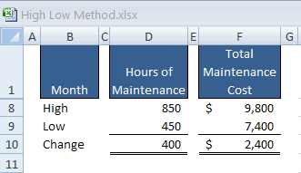
The High-Low Method – An Example
Total Fixed Cost = Total Cost – Total Variable Cost
Total Fixed Cost = $9,800 – ($6/hour × 850 hours)
Total Fixed Cost = $9,800 – $5,100
Total Fixed Cost = $4,700
Notes:
The fourth step is to take the total cost at either activity level (in this case, $9,800).
Deduct the variable cost component ($6 per hour times 850 hours) for the total cost of $5,100.
The difference represents the estimate of total fixed costs ($4,700).

Slide 11
The High-Low Method – An Example
The Cost Equation for Maintenance
Y = $4,700 + $6.00X
Notes:
The fifth step is to construct an equation that can be used to estimate the total cost at any activity level (Y = $4,700 + $6.00X). The basic equation of Y is equal to $4,700 (the total fixed cost) plus $6 times the actual level of activity.
You can verify the equation by calculating total maintenance costs at 450 hours, the low level of activity. It will be worth your time to make the calculation.

Slide 12
Quick Check ✓
Sales salaries and commissions are $10,000 when 80,000 units are sold, and $14,000 when 120,000 units are sold. Using the high-low method, what is the variable portion of sales salaries and commission?
a. $0.08 per unit
b. $0.10 per unit
c. $0.12 per unit
d. $0.125 per unit
Notes:
See if you can apply what we have just discussed to determine the variable portion of sales salaries and commissions for this company.

Slide 13
Quick Check ✓
Sales salaries and commissions are $10,000 when 80,000 units are sold, and $14,000 when 120,000 units are sold. Using the high-low method, what is the fixed portion of sales salaries and commissions?
a. $ 2,000
b. $ 4,000
c. $10,000
d. $12,000
Notes:
Using the same data, calculate the total fixed cost portion of sales salaries and commissions.

Slide 14
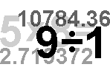
Least-Squares Regression Method
A method used to analyze mixed costs if a scattergraph plot reveals an approximately linear relationship between the X and Y variables.
This method uses all of the
data points to estimate
the fixed and variable
cost components of a
mixed cost.
The goal of this method is
to fit a straight line to the
data that minimizes the
sum of the squared errors.
Notes:
This method can be used to analyze mixed costs if a scattergraph plot reveals an approximately linear relationship between the X and Y variables.
The least-squares regression method is a more sophisticated approach to isolating the fixed and variable portion of a mixed cost. This method uses all of the data points to estimate the fixed and variable cost components of a mixed cost. This method is superior to the scattergraph plot method that relies upon only one data point and the high-low method that uses only two data points to estimate the fixed and variable cost components of a mixed cost.
The basic goal of this method is to fit a straight line to the data that minimizes the sum of the squared errors. The regression errors are the vertical deviations from the data points to the regression line.

Slide 15

Least-Squares Regression Method
Software can be used to fit a regression line through the data points.
The cost analysis objective is the same: Y = a + bX
Least-squares regression also provides a statistic, called the R², which is a measure of the goodness
of fit of the regression line to the data points.
Notes:
The formulas that are used for least-squares regression are complex. Fortunately, computer software can perform the calculations quickly. The observed values of the X and Y variables are entered into the computer program and all necessary calculations are made.
The output from the regression analysis can be used to create an equation that enables you to estimate total costs at any activity level.
The key statistic to look at when evaluating regression results is called R squared, which is a measure of the “goodness of fit.”
In the appendix to this chapter, we show you how to use Microsoft Excel to complete a least-squares regression analysis.

Slide 16
Using Excel to do regression
Excel is a great tool for graphing and doing regressions.
  Put the data into columns
To graph, highlight the data, click insert, and scatter (select the top left graph option)
To do regression analysis, click data, data analysis (if this doesn’t appear, click file-options-add ins-analysis tool pak then ok) and then regression.

Slide 17
Using Excel to do regression
After clicking regression, a box will pop up.
  You need to tell excel where the X data is (the independent variable), the Y data is (the dependent variable) and where to put the output (below your data).
Key data is:
  Adjusted R Squared – tells us how well the model fits the data
  Intercept coefficient – estimate of a
  X Variable 1 coefficient – estimate of b
  t – Stat for the coefficients – want >2

Slide 18
Comparing Results From the Two Methods
The two methods just discussed provide different estimates of the fixed and variable cost components of a mixed cost.
This is to be expected because each method uses differing amounts of the data points to provide estimates.
Least-squares regression provides the most accurate estimate because it uses all the data points.
Notes:
The three methods just discussed provide slightly different estimates of the fixed and variable portions of a mixed cost. This is to be expected because each method uses differing amounts of the data points to provide estimates. Least-squares regression provides the most accurate estimates because it uses all of the data points.

